Slide 1
HealthChain Cannabis Prescriber 2.0
Adam Cole

Slide 2
Demographics & Prescribed
Demographics
Name, DOB (age), Gender (at birth)
Optional: Identifies as, weight, height, photo
Treatment: Condition(s), symptom(s)
Contraindications: Hx, Med Hx
Filters
Strain, CBD >=, THC <=, format
Show secondary filters
Suggest
In stock, avoid munchies, avoid intoxication, avoid drowsiness
List
Strain, LP, CBD, THC, forma, rating, in-stock, price
Details
Big picture, description, Total grams
Strain: Indica, Sativa, Hybrid
Format: Dried, oil, decarb, blend, Softgels, Dissolve strips
Src: https://www.auroramj.com/strains/
Filters
Suggest
List
Details

Slide 3
To do
n/a or non-legible value of THC --> default = 0% (counsellor uses judgement)
Add terepens (add column for terepens “primary terepen”)
Add to patient demographics: allergies
MD includes g/day --> counsellor converts to g/month, duration
On Pt. demographics possibly show duration *e.g. 6 mos" (doesn't actually impact counsellor in CRX; but is valuable for setting follow-up visit)
Order: amount, signature
Sort with Aurora at top
Compare product A & product B
Filters: highest rated for {pain, insomnia, anxiety, depression,…}

Slide 4
CCC Feedback
FYI (no action required
One-click renewal
One-click registration
Filter by medical document
Patient gets exactly what they chose with the counsellor
Adam: Consider removing contraindications as it could train counsellor to depend on it. (e.g. blood thinners are important to know)
Automatically pull up the patient from Ora (CC prescriber is in patient context of Ora)
Current: Locate patient by: phone number, email, full name
Strain review: not being done by counsellors, but would be useful for data science (automate through email survey; option for counsellor to perform/skip/send email survey)
Devon Kerr: populates DB (in-stock, price updates) every (ideally) morning; and oil conversion
CC To do
However, Dr/NP should not be allowed to enter "n/a" or non-numeric
6 or 7 basic terpenes (NP Shirley know terpenes)
formats: flower, oil, pills/capsule, patient ready/decarb, edibles, vapes
Desire to back-order out-of-stock product and/or for LP to refill 1~2 wks before duration ends
Add filter: "compassionate pricing" (filters out LPs that don't offer compassionate pricing)
encouraged not to specify strain; CBD is open; THC is important variable
Need a per product oil to dried %THC conversion
Could use same product for both night and day (dilute oil more in the day than at night)
Default order size based on 5gm for dried or 1 bottle for oil
Roe: larger font
Iterate through multiple MDs in one session. (CRX requires logging out and logging back in)
Pts are now averaging 2~3 MDs each
As each MD's order is completing, mark the MD as completed and iterate to next one
Consider allowing counsellor to select follow-up appointment time with patient
Patient signing option (docusign or express consent or...) – Kim currently signs o.b.o. pt.
ODSB for Vape (understand from Nasir / Kim)

Slide 5
Scratch work follows

Slide 6
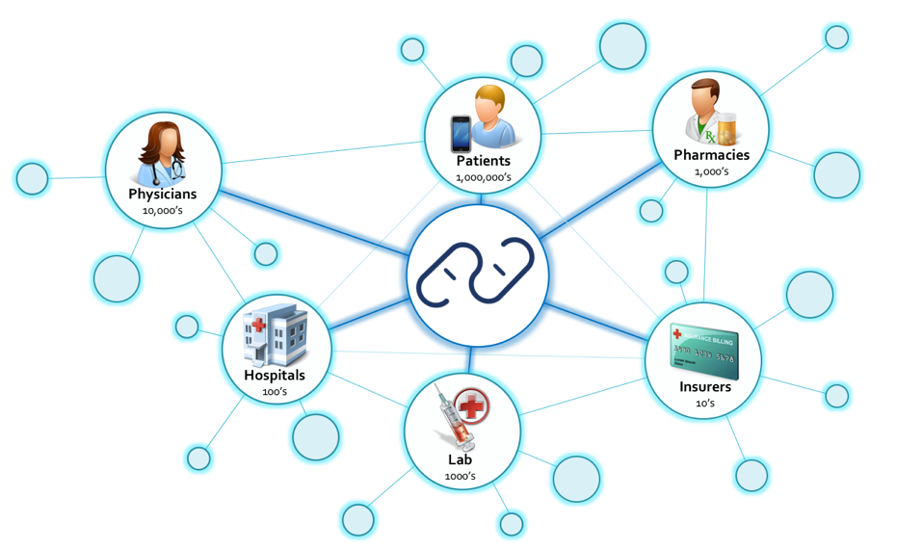

Slide 7
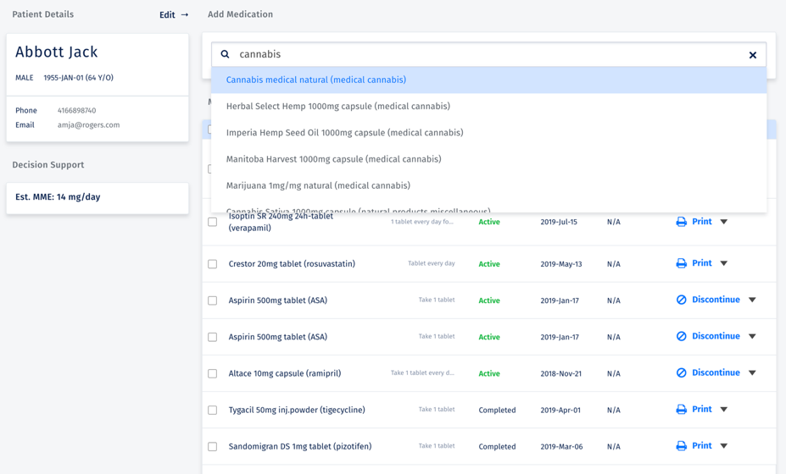

Slide 8
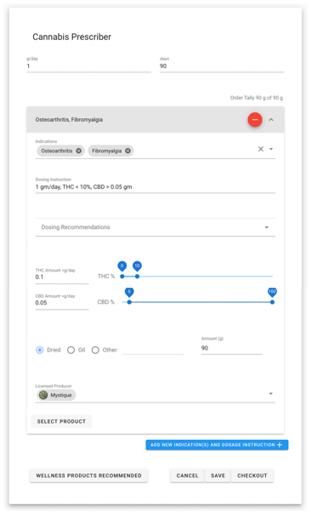

Slide 9
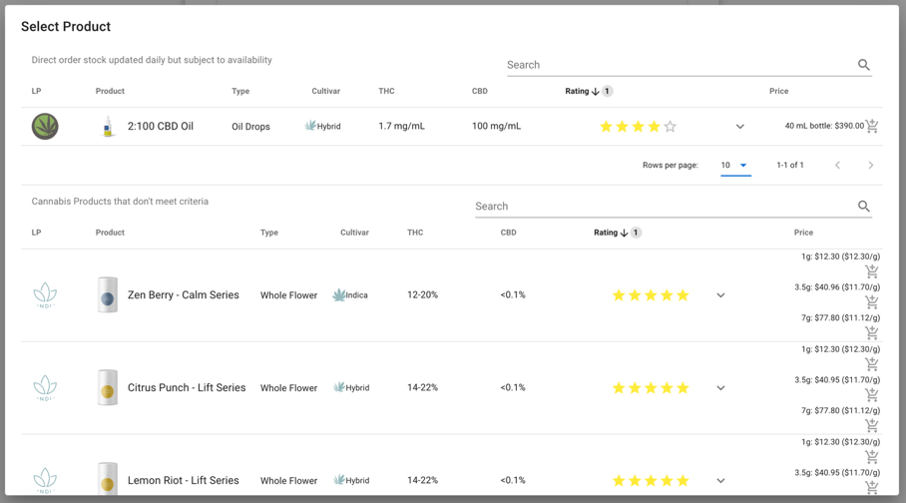

Slide 10
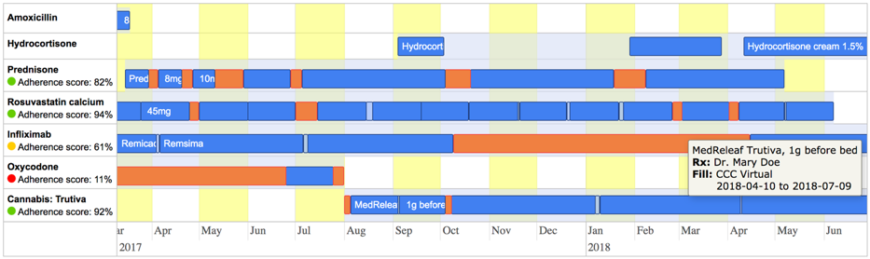

Slide 11
